Slide 1
STYLES OF QUESTIONS
IN CHEMISTRY WACE
EXAMS

Slide 2
MULTIPLE CHOICE QUESTIONS
25 questions with 4 alternatives carrying 25% of the marks.
This section should take about 45 minutes
(ie approximately 1.8 minutes or 108s each).
Read ALL alternatives before responding.
Select the BEST alternative.
Provide one response for every question.

Slide 3
SHORT ANSWER QUESTIONS
35% of the total examination consisting of 8–12 questions
Suggested working time: 60 minutes
The questions could require you to respond with
equations, descriptions, short calculations, diagrams,
tables, graphs or flow charts.

Slide 4
SHORT ANSWER QUESTIONS
What are some typical short answer questions?
Write an equation OR describe observations.
Draw Lewis Diagrams (ie electron dot) diagrams.
Determine shape and polarity.
Effect of changes to equilibrium systems.
Rate, yield and graphs.

Slide 5
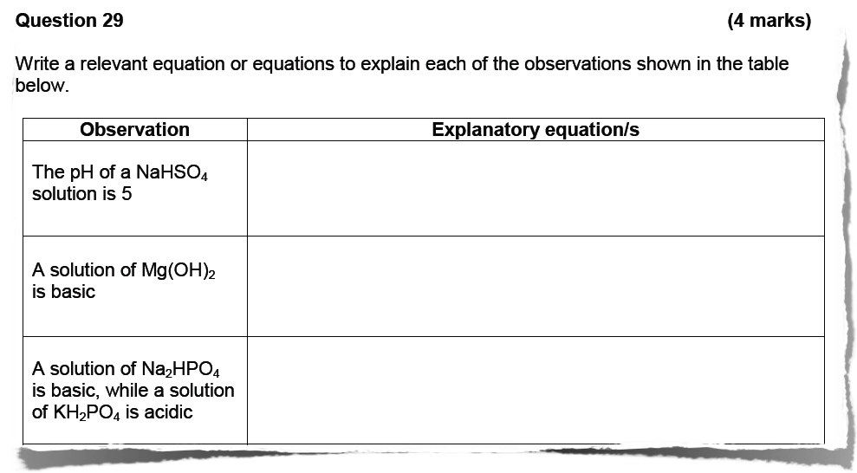
SHORT ANSWER QUESTIONS
eg

Slide 6
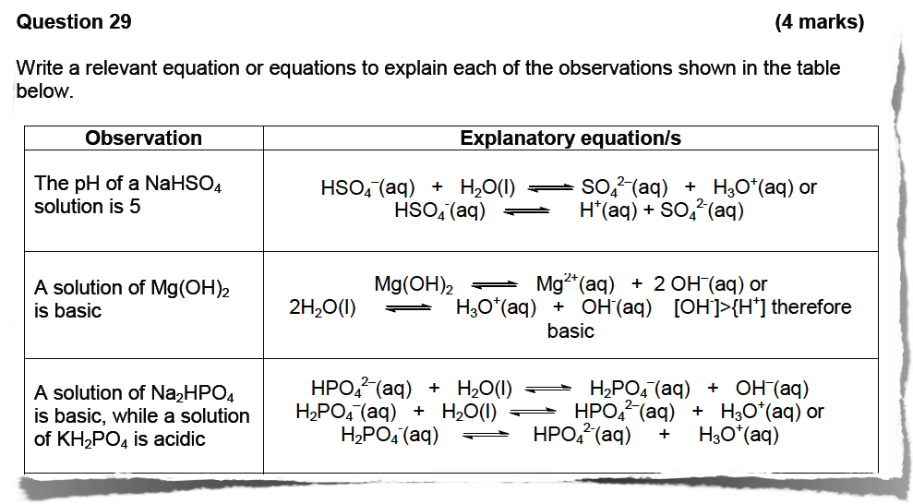
SHORT ANSWER QUESTIONS

Slide 7
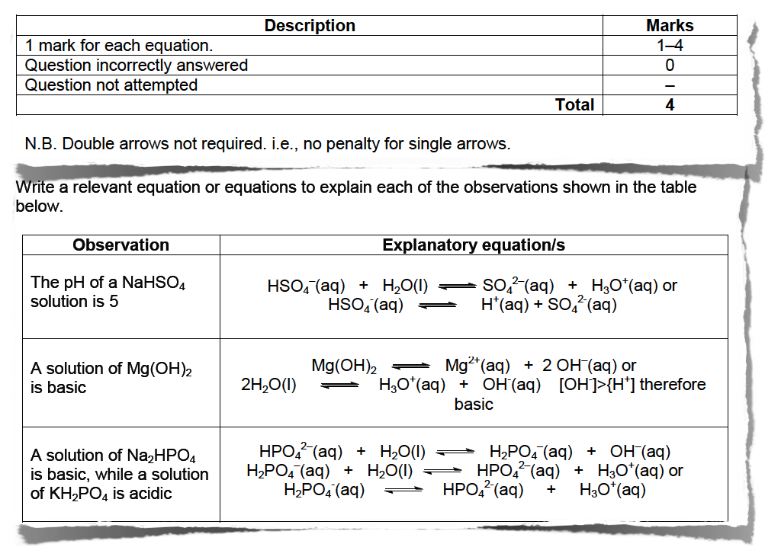
SHORT ANSWER QUESTIONS

Slide 8
SHORT ANSWER QUESTIONS

Slide 9
SHORT ANSWER QUESTIONS

Slide 10
SHORT ANSWER QUESTIONS

Slide 11
SHORT ANSWER QUESTIONS

Slide 12
SHORT ANSWER QUESTIONS

Slide 13
SHORT ANSWER QUESTIONS

Slide 14
SHORT ANSWER QUESTIONS

Slide 15
SHORT ANSWER QUESTIONS

Slide 16
SHORT ANSWER QUESTIONS

Slide 17
SHORT ANSWER QUESTIONS

Slide 18
SHORT ANSWER QUESTIONS

Slide 19
SHORT ANSWER QUESTIONS
eg

Slide 20
SHORT ANSWER QUESTIONS
Eg Periodic trends:

Slide 21
SHORT ANSWER QUESTIONS
eg

Slide 22
SHORT ANSWER QUESTIONS
eg

Slide 23
EXTENDED ANSWER QUESTIONS
40% of the total examination consisting of 5–7 questions
Suggested working time: 70 minutes
Each question has parts and is based on a scenario.
At least two multi-step calculation questions are included.
Stimulus materials for scenarios and text analysis or comprehension could take the form of technical or historical passages or experimental data, and could include images, diagrams, graphs and charts.
Answers could include written responses, multi-step calculations or flowcharts, either singly or in combination

